Slide 1

Rajasthan Police Hackathon 1.0
DEEPFAKE DETECTION
Team Members:
1. Prisha Ganganmale
2. Sakshi Dhamane
3. Anjali Susar
4. Rutuja Khandagale

Slide 2
Introduction
Deep fake is a technique for human image synthesis based on artificial intelligence. Deep fakes are created by combing and superimposing existing images, videos & Audio onto deep learning technique known as generative adversarial network.

Slide 3
Problem statement
This project aims to address this challenge by leveraging advanced deep learning models, specifically ResNext CNN for image analysis and LSTM for temporal sequence modeling in videos.
The objective is to develop an effective and robust deepfake detection system capable of discerning manipulated content, thereby safeguarding the integrity of visual information in various domain

Slide 4
Objective
Develop a Robust Deepfake Detection Model
Address Multiple Modalities
Define and Classify Manipulation Types
Utilize ResNext CNN for Image Analysis
Integrate Audio Analysis for Comprehensive Detection
Incorporate LSTM for Temporal Sequence
ModelingContribute to Proactive Cybersecurity Measures

Slide 5
Why Deep Fake Detection ?
Fake News
Malicious hoaxes
Financial fraud
Celebrity unusual video
Revenge porn
Politician videos

Slide 6
Algorithm
For videos
Upload Videos
Preprocessing
Train/Test Data Split
Model Training
Model Evaluation
Load Trained Model
Prediction on New videos
Display Result

Slide 7
Algorithm
For Images
Preprocessing
Train/Test Data Split
Model Training
Model Evaluation
Load Trained Model
Prediction on New images
Display Result
Upload Images

Slide 8
Algorithm
For Audio
Preprocessing
Train/Test Data Split
Model Training
Model Evaluation
Load Trained Model
Prediction on New Audio clip
Display Result
Upload Audio

Slide 9
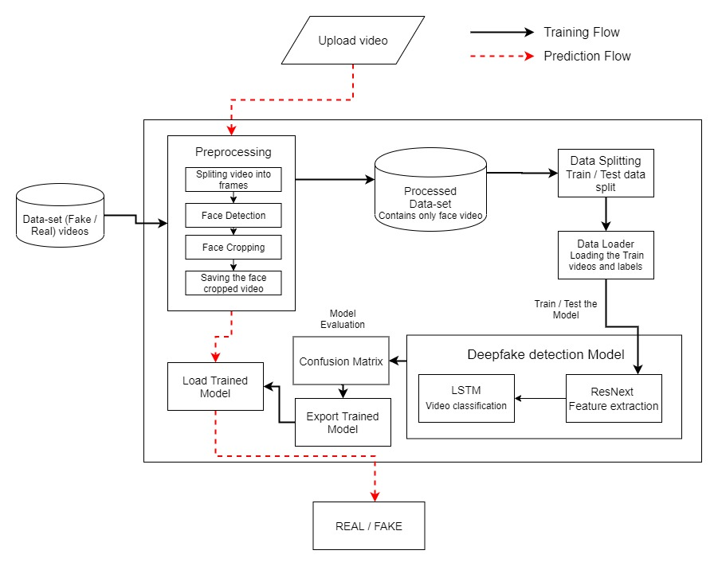
Architecture
Video:

Slide 10
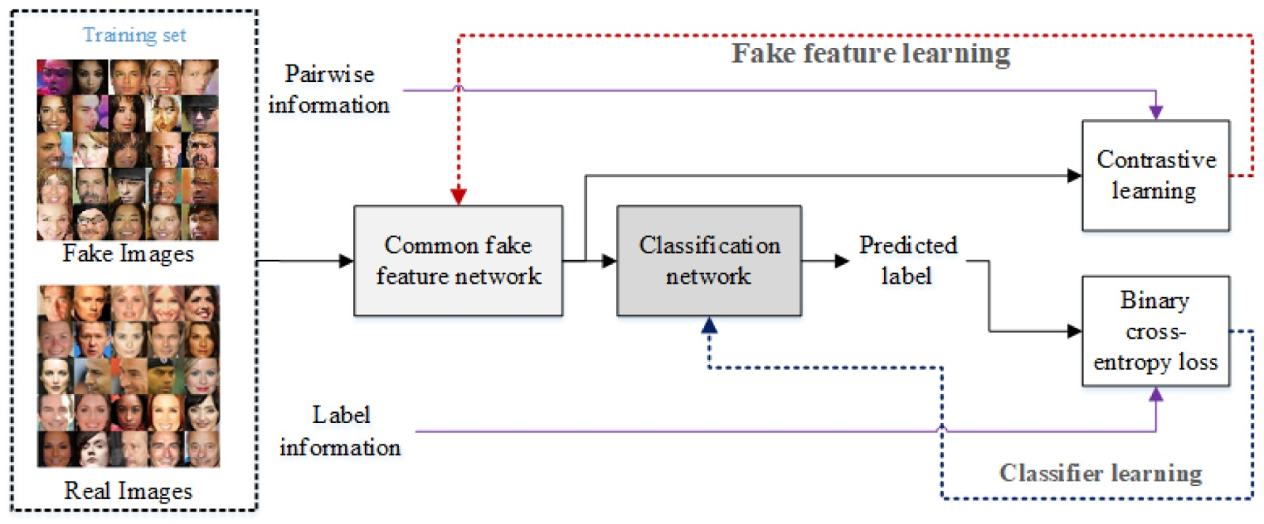
Architecture
Image:

Slide 11
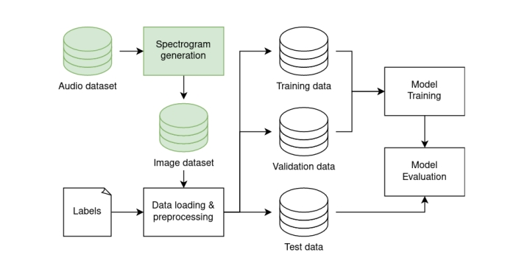
Architecture
Audio:

Slide 12
Solution
Data Collection and Preparation
Feature Engineering
Model Selection and Training
Validation and Evaluation:
Deployment and Integration

Slide 13
Future Scope
Real-time Detection Capabilities
AI-Generated Content Detection
Privacy-Preserving Detection
Dataset Diversity and Bias Mitigation

Slide 14
Thank You!!

